Slide 1
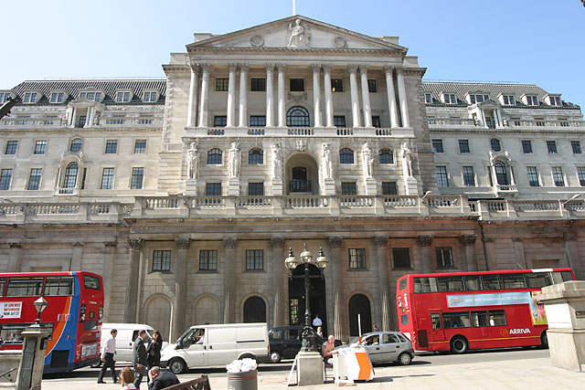
The Bank of England
James Chiu
Nicholas Jozefczyk
Vinson Pham

Slide 2
Bank’s Primary Objective
The Bank should continue to improve the quality and efficiency of the processes supporting the Monetary Policy Committee, advance the analysis, practice and communication of inflation targeting, and enhance its understanding of the changing inflation process.
-Bank of England’s Strategic Priorities 2009 http://www.bankofengland.co.uk/about/strategy/index.htm
The Bank of England’s main focus is on monetary stability with a target inflation rate set at 2%. The bank decides upon a short-term interest rate intended to drive the economy towards the desired inflation target and price stability.
This inflation targeting policy has put great strain on a country experiencing a negative short-term output gap. As a result, the bank has neglected their goal of monetary stability and focused more greatly on its second core focus: financial stability.

Slide 3
The UK’s Recent Economic History
%
Sources:
CPI Monthly and GDP Quarter on Quarter Growth (Chained 2003 dollars) SA time series data from :
www.statistics.gov.uk/statbase
Bank rate history from : www.bankofengland.co.uk
1989 2009

Slide 4

Current Economic Climate
GDP - DOWN!!!
Domestic Activity – WEAK!!!
Inflation Outlook – GRIM!!!
Financial Climate – VOLATILE!!!

Slide 5
Quarterly GDP Growth
GDP reportedly fell by -1.5% in Q4 2008.
Largest quarterly fall since 1980.
2000
Sept. 01

Slide 6
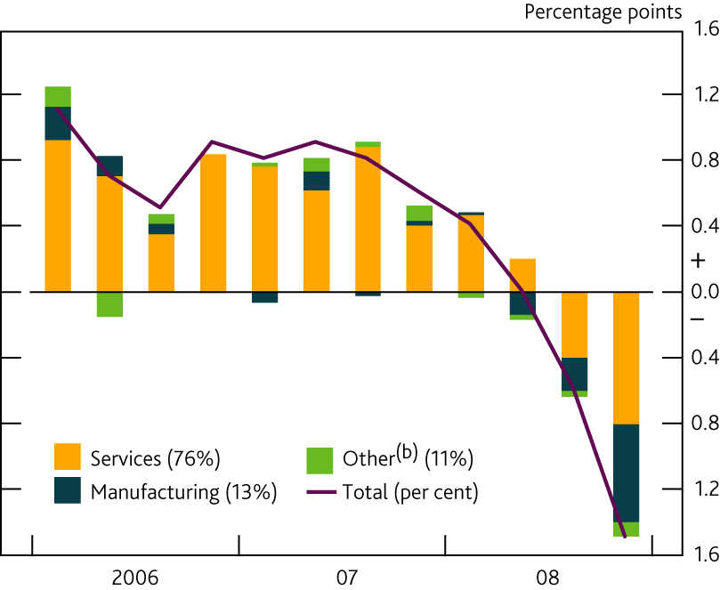
The fact that the GDP has dropped so severely in this financial crisis suggests the need for the Bank of England to enact expansionary policy. We will save our finally policy recommendation until we fully examine the UK economy.
Contributions to quarterly GDP growth^{(a)}
➔
(a) Chained-volume measures, at basic prices. The figures in parentheses show shares in the level of nominal value added in 2007. Contributions do not sum to GDP due to rounding.
The chart shows data consistent with January’s preliminary GDP release. Production data were subsequently revised.
(b) Includes agriculture, mining and quarrying, electricity, gas and water supply and construction.

Slide 7
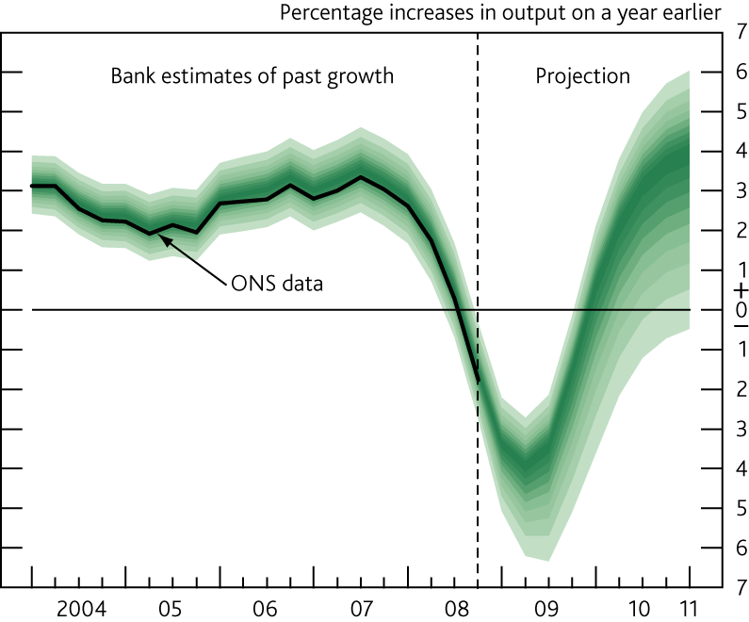
GDP projection based on constant nominal interest rates at 1%
The fan chart depicts the probability of various outcomes for GDP growth. To the left of the first vertical dashed line, the distribution reflects the likelihood of revisions to the data over the past; to the right, it reflects uncertainty over the evolution of GDP growth in the future. If economic circumstances identical to today’s were to prevail on 100 occasions, the MPC’s best collective judgement is that the mature estimate of GDP growth would lie within the darkest central band on only 10 of those occasions.

Slide 8
The graph on the previous page shows what is forecasted to happen if the Bank decides to leave the bank rate at 1%. Although an uptick in the output gap is expected, it is not until 2010 at the earliest that the economy is expected to return to a positive output gap. This may not be a sufficiently strong policy, as many of the other aspects of the domestic economy are expected to worsen.

Slide 9
Current UK Policy
Current Bank Rate 0.5% (3/5/09)
Next due: 9 Apr '09
Current Inflation (CPI) 3.0%
Next due: 24 Mar '09
Inflation Target 2.0%
Next due: Feb '09
Next Inflation Report 13 May '09

Slide 10

Domestic Activity
Downturn in world economy
Further Tightening of Credit

Slide 11
Domestic Conditions
Falling house prices.
Low mortgage approval.
Biggest investment drop since 1980.
European Commissions Economic Sentiment Indicator (a series of surveys dealing with all sectors of the economy) for UK at an all –time low.
http://www.tradingeconomics.com/Economics/GDP-Growth.aspx?Symbol=GBP

Slide 12
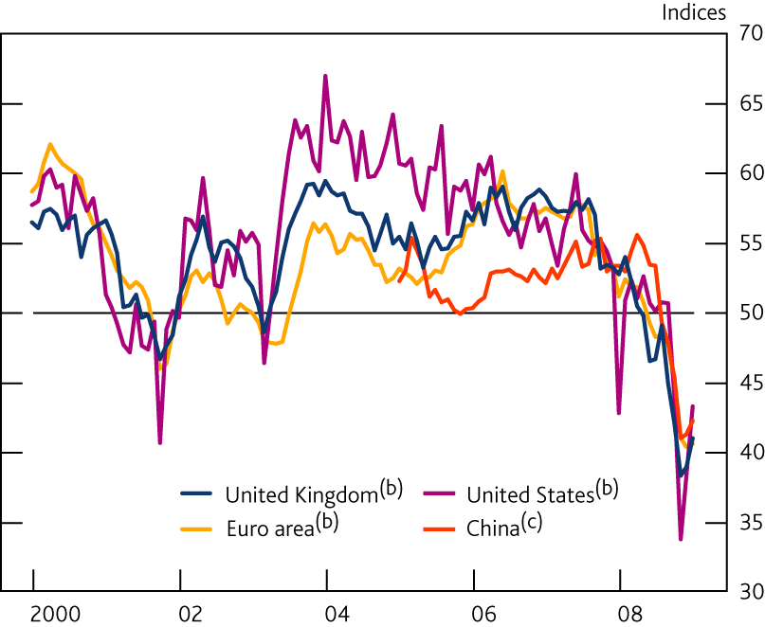
UK’s Business Output Compared to International Output
Chart 2.1 Business surveys of output in selected countries^{(a)}
Sources: Bloomberg, Bureau of Economic Analysis, CIPS/Markit, Eurostat, Institute for Supply Management and ONS.
(a) A figure over 50 indicates rising output compared with the previous month, and a figure below 50 indicates falling output.
(b) Manufacturing and services headline indices, weighted together using shares in real output.
(c) Manufacturing index only.

Slide 13
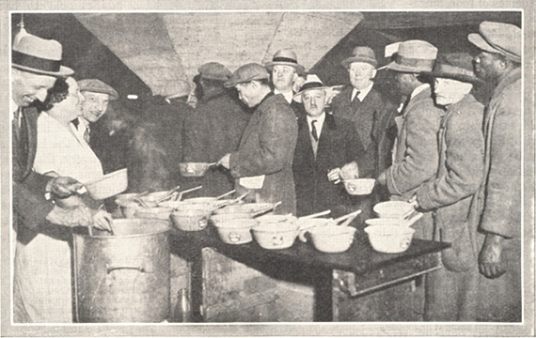
The Response of Businesses
Reducing Output
Scaling investment plans
Running down inventories
Cutting labor

Slide 14
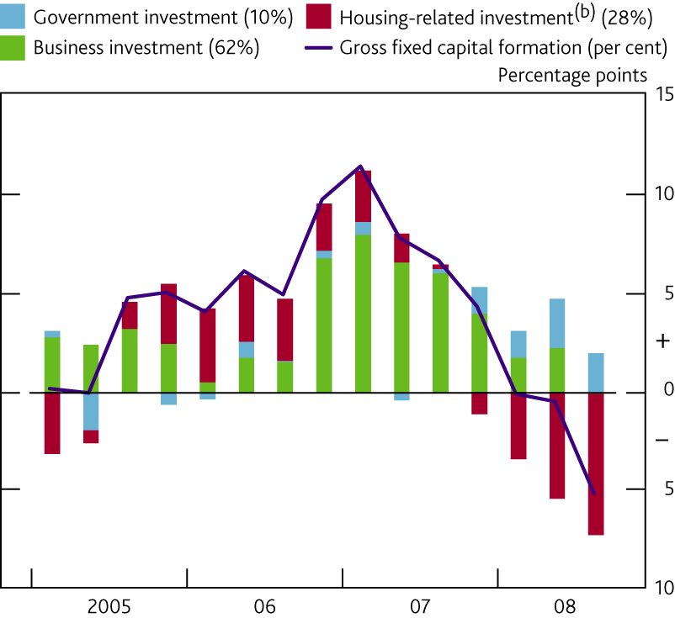
Chart 2.10 Contributions to four-quarter growth in gross
fixed capital formation^{(a)}
(a) Chained-volume measures. The figures in parentheses show shares in the level of gross fixed capital formation in 2007.
(b) Includes dwellings investment and costs associated with the transfer of ownership of buildings, dwellings and non-produced assets, primarily stamp duty on housing
transactions and estate agents’ fees.

Slide 15
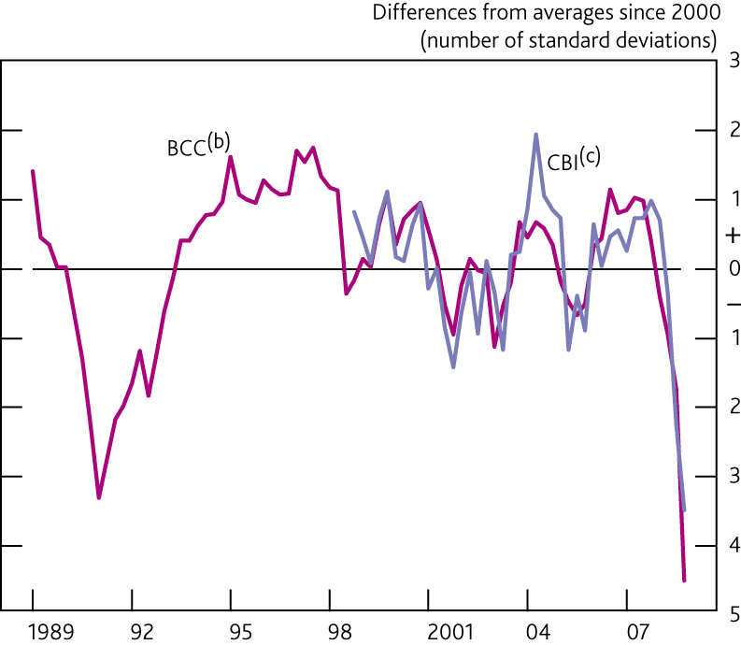
Chart 2.11 Investment intentions (plant and machinery)^{(a)}
Sources: BCC, CBI, CBI/PwC and ONS.
(a) Measures weight together sectoral surveys using shares in real business investment.
(b) Net percentage balances of companies who say they have revised up their planned investment in plant and machinery over the past three months. Data are non seasonally adjusted.
(c) Net percentage balances of companies who plan to increase investment in plant and machinery over the next twelve months.

Slide 16
Consumption Outlook
Consumer spending contracted in 2008
Falling employment, lower financial wealth and tight credit conditions likely to weigh down consumers’ expenditures.
Increased uncertainty about job prospects may cause households to lower spending in reduce debt and increase savings.

Slide 17
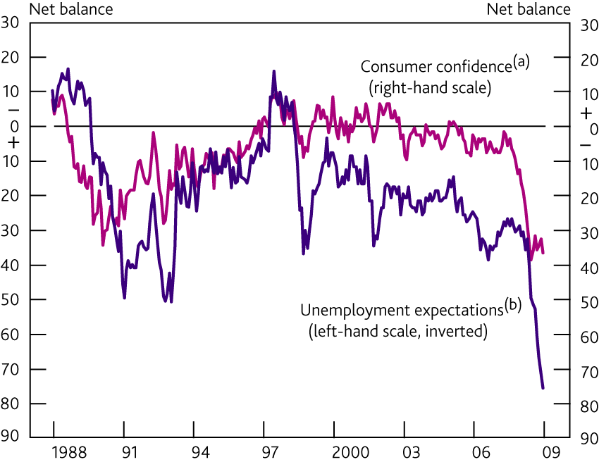
Chart 2.9 Indicators of consumer confidence
Source: Research carried out by GfK NOP on behalf of the European Commission.
(a) Headline GfK measure. Data are non seasonally adjusted.
(b) The GfK survey asks respondents how they expect unemployment to evolve over the next year.

Slide 18
Employment
According to Labour Force Survey employment has decreased by 100,000 since mid 2008.
Unemployment continues to rise, currently at 6.0%.
Highest unemployment rate in nearly a decade.

Slide 19
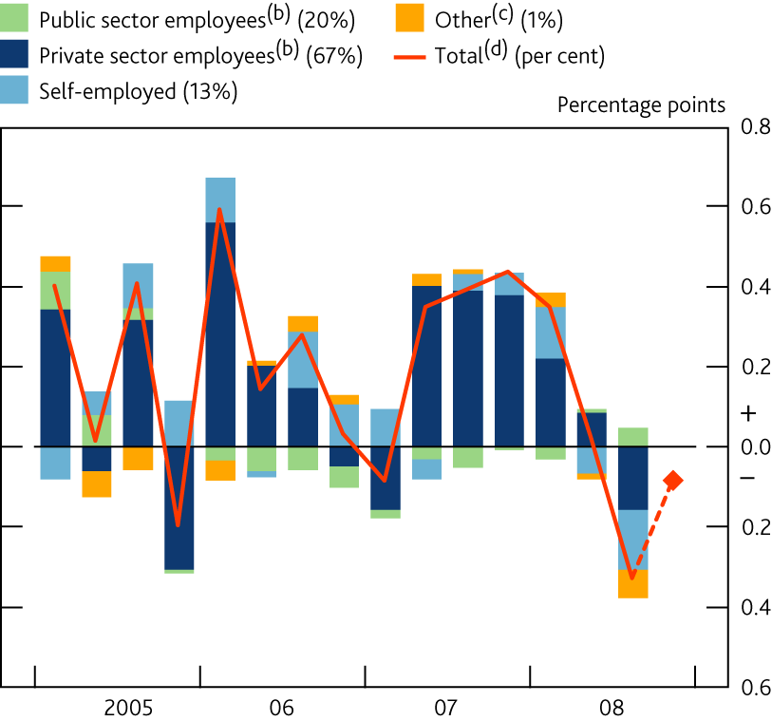
Chart 3.7 Contributions to quarterly LFS employment growth^{(a)}
Source: ONS (including Labour Force Survey).
(a) Figures in parentheses are shares in total employment in 2007 and do not sum to 100% due to rounding.
(b) Data have been adjusted to be on a calendar-quarter basis.
(c) Unpaid family workers and government-supported trainees.
(d) The diamond shows employment growth in the three months to November.

Slide 20
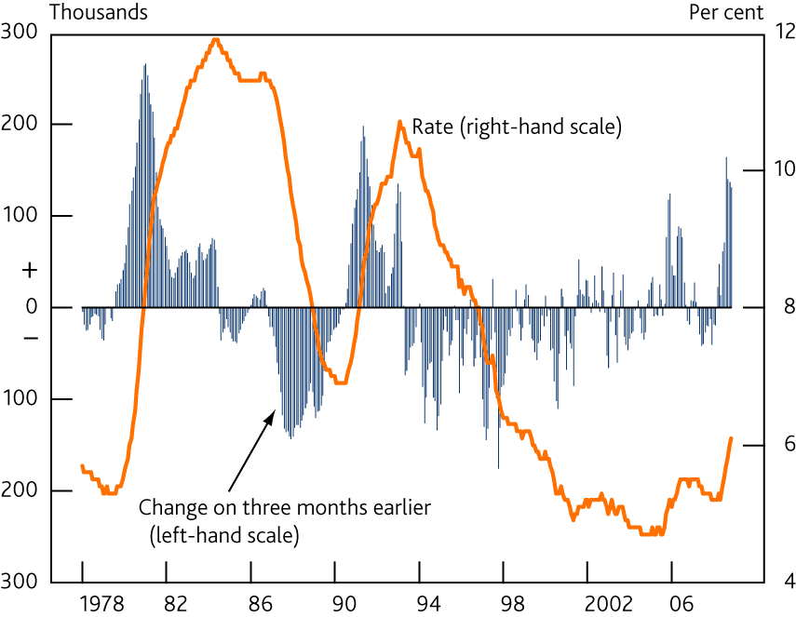
Chart 3.8 LFS unemployment
Source: Labour Force Survey.

Slide 21
UK Exports
Global slowdown has greatly reduced the demand for UK exports.
Goods exported fell by 2.8% in October, 5.3% in November.
Survey of manufacturing export orders suggest exports may continue to decline.

Slide 22
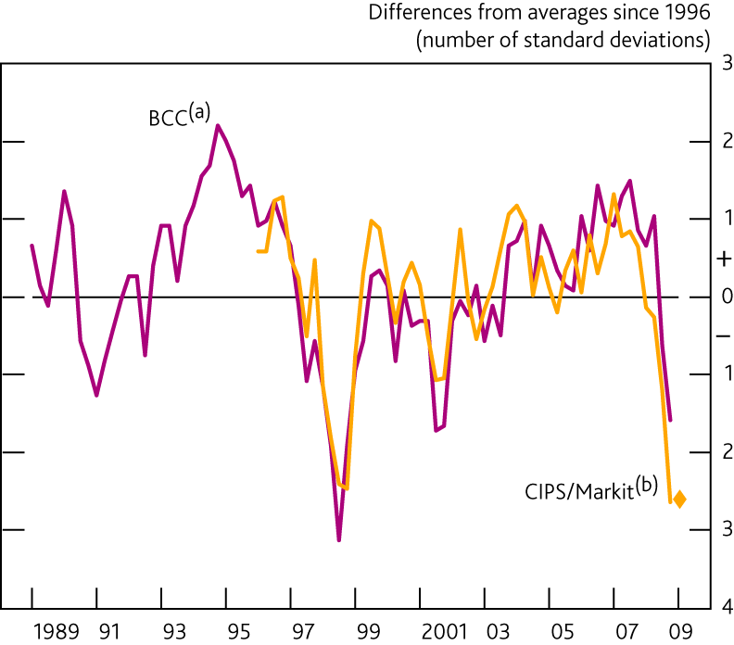
Chart 2.5 Survey indicators of UK manufacturing export orders
Sources: BCC (British Broadcast Corporation) and CIPS/Markit. Chartered Institute of Purchasing and Supply
(a) Net percentage balance of manufacturing companies saying that export orders increased on the quarter.
(b) Manufacturing companies saying that export orders increased this month compared with previous month. Quarterly averages. The diamond for 2009 Q1 is based on January data.

Slide 23
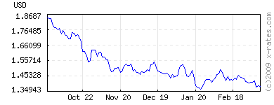
Exchange Rate
Current Conversion: 1 Pound = 1.38 USD
Given a low XR, the UK’s exports should be expected to rise given the increase in the purchasing power of international consumers. However, UK’s net exports rely on financial and business services of countries that, for the most part, are experiencing negative GDP growth of their own.
http://www.tradingeconomics.com/Economics/GDP-Growth.aspx?Symbol=GBP
USD to GBP
http://www.x-rates.com/d/USD/GBP/graph120.html

Slide 24
CPI Inflation Value Added Tax
CPI inflation fell from 5.2% in September to 3.1% in December.
Fall in CPI attributed to decrease in oil price and a direct impact of the cut in VAT from 17.5% to 15%.
Around 70% of goods and services are affected by the temporary decrease in VAT.
Change in CPI due to reduction in VAT roughly 1.5%.
Unfortunately, this temporary reduction in VAT is not expected to increase household consumption, as concerns over growing unemployment and worsening economic conditions overweigh any incentives to increase spending.

Slide 25
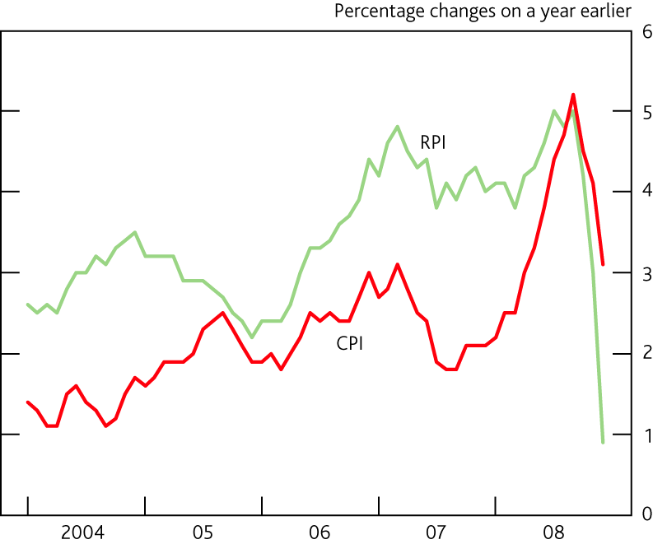
CPI –Consumer Prices Index
RPI - Retail Prices Index-(Includes indexation of pensions, housing)
Chart 4.1 Measures of consumer prices

Slide 26
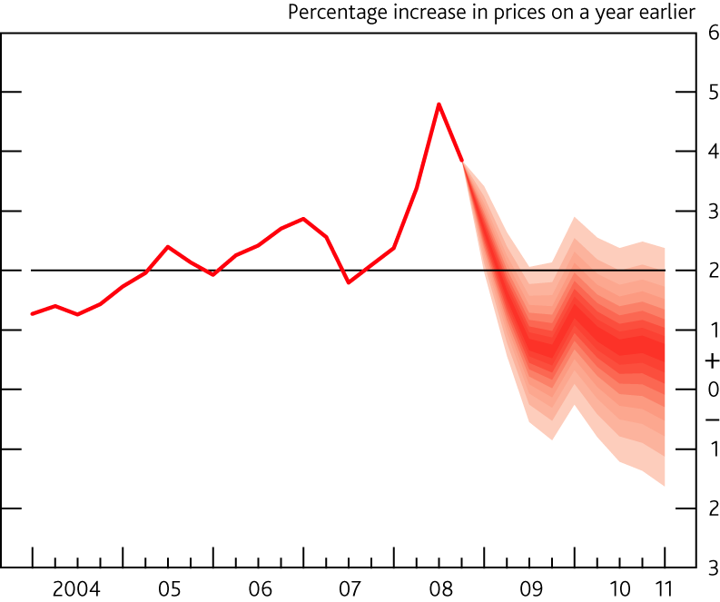
Inflation Forecast Based on Current Interest Rate
Chart 5.6 CPI inflation projection based on constant nominal interest rates at 1%
Monetary Policy Committee-The fan charts depict the probability of various outcomes for CPI inflation in the future. If economic circumstances identical to today’s were to prevail on 100 occasions, the MPC’s best collective judgement is that
inflation over the subsequent three years would lie within the darkest central band on only 10 of those occasions

Slide 27
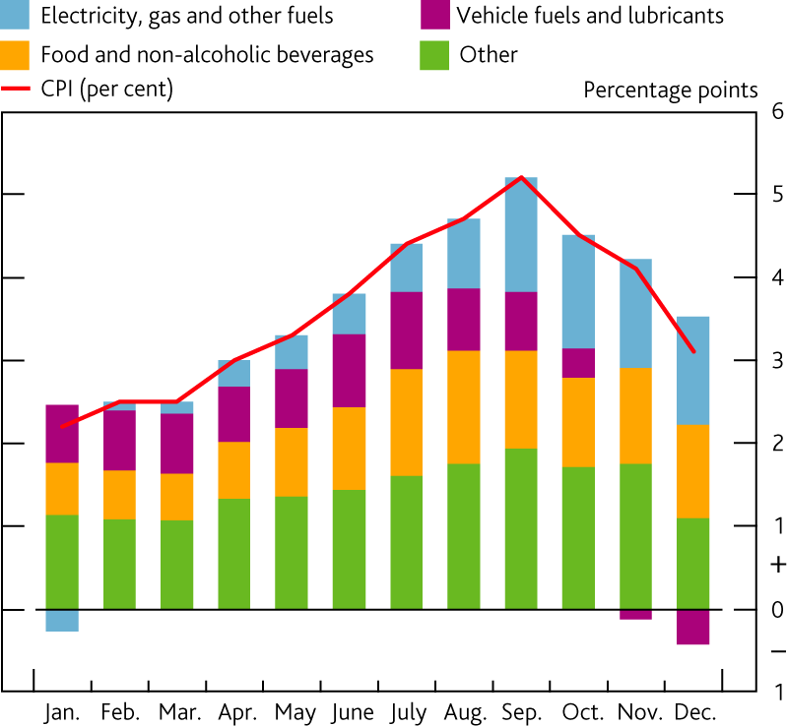
Chart 4.2 Contributions to CPI inflation^{(a)}
(a) Contributions to annual (non seasonally adjusted) CPI inflation.

Slide 28

Financial Markets
Deteriorating global economic outlook putting strains on financial and credit markets.

Slide 29
Lending
Since the summer of 2007, banks have been seeking to restructure their balance sheets through:
-injections of new capital
-selling assets
-cutting back on lending.
The process of deleveraging became necessary following a period during which banks’ balance sheets had grown rapidly relative to their capital bases.
Tightening of credit is a critical obstacle for the economy to overcome in order for corporations and households to function properly.

Slide 30
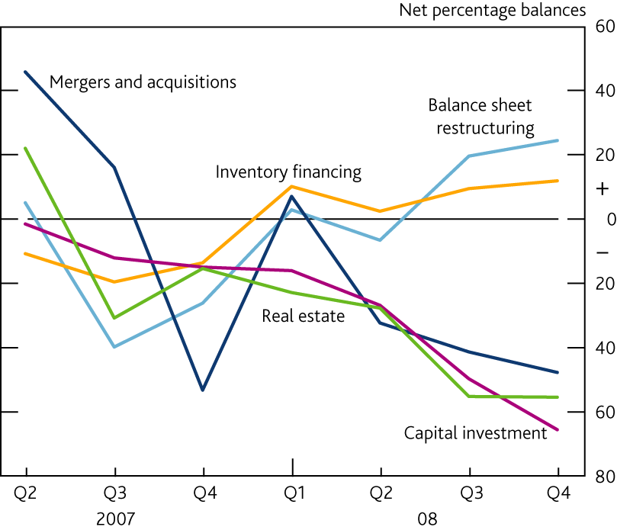
Chart 1.10 Credit Conditions Survey: changes in demand for
corporate lending by purpose^{(a)}
(a) Weighted responses of lenders. A positive balance indicates an increase in demand for lending for that purpose.

Slide 31
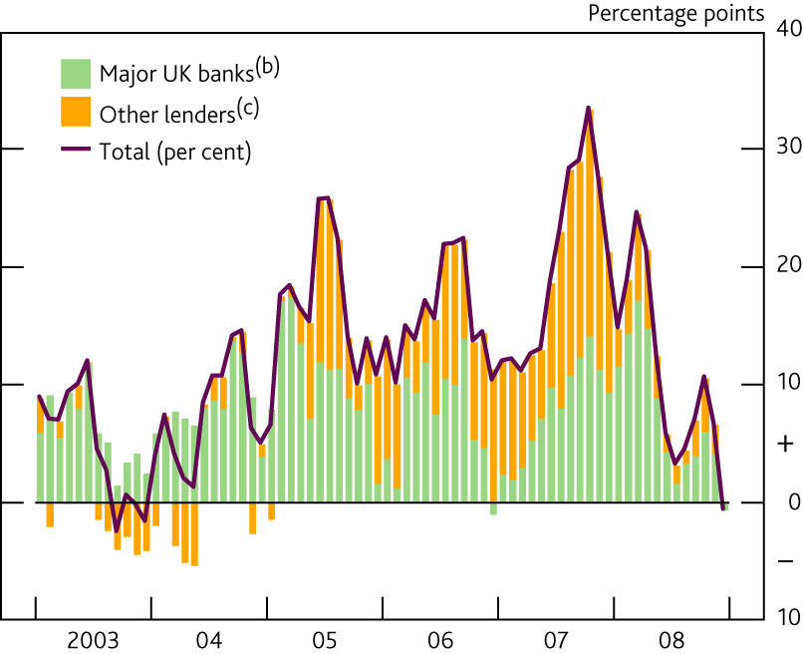
Chart 1.7 Growth in loans to PNFCs^{(a)}
(a) Annualised percentage changes over the past three months. Data are non seasonally adjusted.
(b) This group comprises Abbey, Barclays, HBOS, HSBC, Lloyds TSB and Royal Bank of Scotland.
(c) Calculated as a residual.

Slide 32
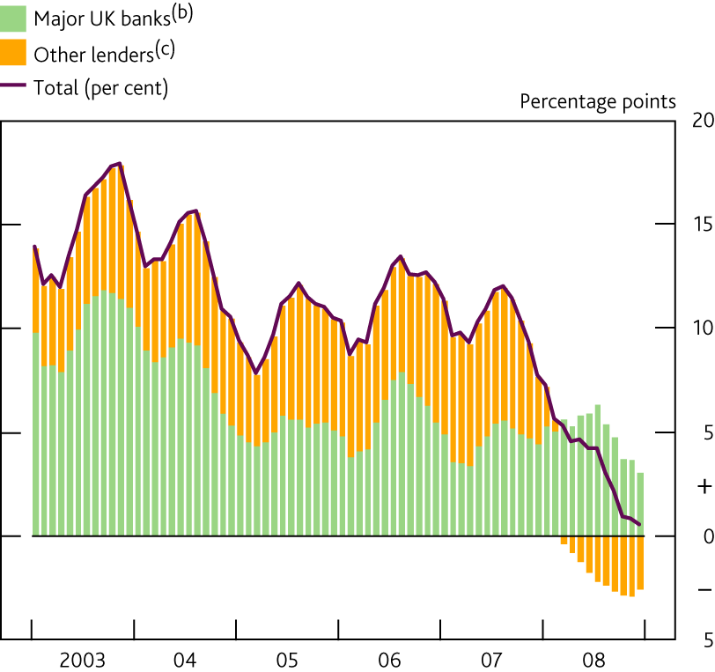
Chart 1.11 Growth in household net secured lending^{(a)}
(a) Annualised percentage changes over the past three months. Data are non seasonally adjusted.
(b) This group comprises Abbey, Barclays, HBOS, HSBC, Lloyds TSB, Nationwide and Royal Bank of Scotland.
(c) Calculated as a residual.

Slide 33
Table 1.C Lending to individuals
Percentage changes on a year earlier
Averages 2008
1996 to 2007 Oct. Nov. Dec.
Total lending 10.2 4.7 4.1 3.6
Secured 9.5 4.5 3.9 3.4
Consumer credit 13.8 5.4 5.1 5.0
of which, credit card 18.0 8.0 8.2 7.4
of which, other unsecured 12.5 4.5 4.2 4.2

Slide 34
Credit Default and Viability of Banks
The macroeconomic outlook has deteriorated, sharply increasing uncertainty over future asset values.
Despite significant injections of new capital following the 8 October package, concerns over banks’ abilities to absorb potential losses persisted.
This was reflected in the relatively high price market participants continued to pay to hedge against banks defaulting.
Reflected in lower credit availability, as banks continued to face rises in both defaults by borrowers and the average loss faced on each default.

Slide 35
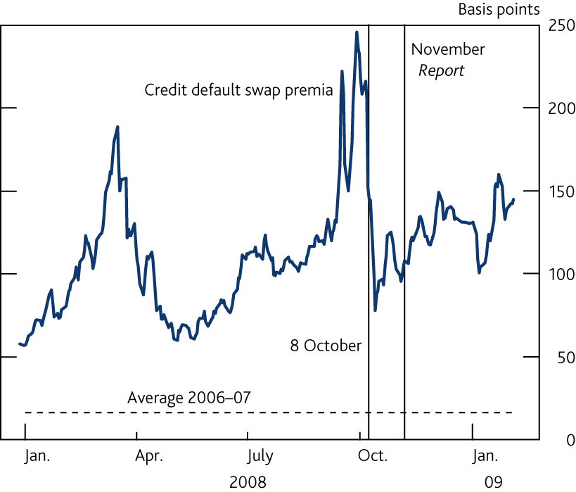
Chart 1.3 Major UK banks’ credit default swap premia^{(a)}
Sources: Markit Group Limited, Thomson Datastream, published accounts and Bank calculations.
(a) The blue line shows a weighted average of the credit default swap premia of ten major UK banks, weighted by each bank’s share in total assets.

Slide 36
Table 1.A Credit Conditions Survey: defaults and loss given default
Net percentage balances^{(a)}
Averages 2008 2009
2007 Q2–2008 Q1 Q2 Q3 Q4 Q1^{(b)}
Secured lending to households
Default rate 4 47 45 55 66
Loss given default 17 41 55 53 63
Lending to medium PNFCs
Default rate 17 37 53 60 67
Loss given default 3 23 21 68 64
(a) Weighted responses of lenders. A positive balance implies increasing defaults and increasing losses given default.
(b) Banks’ expectations for the following three months, reported in the 2008 Q4 survey.

Slide 37
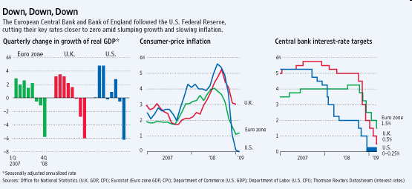
Bank Rate

Slide 38
Asset Purchase Facility
Feb - Created by Bank of England aimed at increasing the availability of corporate credit up to £ 50 Billion, financed through issuance of treasury bills.
Assisting in stimulation of trading activity through increased liquidity, therefore helping to stabilize UK financial markets.
Able to purchase corporate bonds, commercial paper, syndicated loans and asset backed securities.
APF also given framework for Monetary Policy Committee to purchase assets for monetary policy purposes should the committee judge that to be useful to reach the inflation target.

Slide 39
Quantitative Easing
CPI inflation declining by 3.0% in January
A depreciation in the sterling can trigger a dangerous downward spiral in demand.
The February inflation report implied a substantial risk of undershooting the 2% CPI inflation target.
Further easing in monetary policy warranted under such circumstances.
Reduction of Bank Rate to 0.5% not enough to reach targets on inflation.
Using the APF, finance the first £ 75 Billion Asset Purchase program through an issuance of central bank reserves.
This monetary action aimed at boosting supply of money and credit and thus raising the growth of nominal spending to a level consistent with meeting inflation.
The Bank says a shortage of money circulating through the economy poses the biggest obstacle to any recovery, but because it cannot be addressed by cutting interest rates, the only other option is to raise the money supply by buying assets.

Slide 40

Our Policy Recommendation
Bank of England Governor Mervyn King

Slide 41
A quick note.
Although the UK economy is in desperate need of serious expansionary monetary policy, the Bank of England wants to avoid dropping the bank rate down to 0 (as detailed in class in the Friedman debate). This would eliminate the bank’s ability to cut the rate in the future as a policy tool, significantly limiting any power the bank may have.

Slide 42
Our Policy Recommendation
Based upon 1% bank rate:
  Cut the bank rate 50 points to .5% to help stimulate the economy out of its current GDP contraction
  While our basic monetary policy model would suggest an increase in bank rate given the high inflation (R_{t}-r)=m(π_{t}-π_{bar}) , our output concerns dominate our inflation-targeting policy and we want to enact expansionary measures by decreasing the rate to increase the output gap. (Y_{t}=a-b(R_{t}-r) .

Slide 43
Forecasts
Create some bullshit numbers

Slide 44
Inflation Forecast Based on Current Interest Rate
Chart 5.6 CPI inflation projection based on constant nominal interest rates at 1%
See footnote to Charts 5.4 and 5.5.
Notes:
44

Slide 45

BUT…
Prior to our completion of this project, the Bank of England already took action, acting as we would have suggested.
Policy as of 3/5/09:
Decrease in Bank Rate 50 basis points to 0.5%.
Quantitative Easing - issuance of central bank reserves £ 75 Billion Asset Purchase program

Slide 46
Next Month’s Policy Recommendation
Since we have no inflation or output data to work from since Q 4 2008, we can’t yet judge the results of the most recent policy decision.
Depending on the results of this month’s economic activity it may be necessary to have another 25 basis point cut to 0.25%.
And wait further to see the effects of the £75 Billion Asset Purchase program over the next 3 months.

